Slide 1




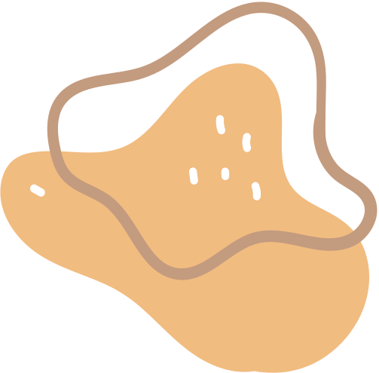


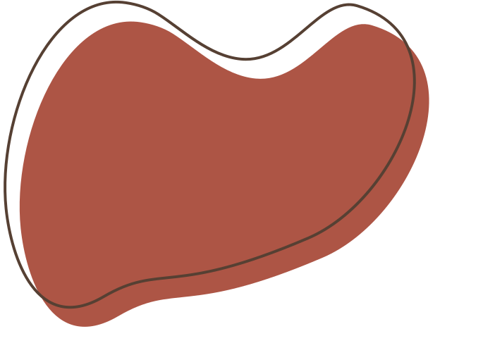
PATHFIT III
Presented by Group V

Slide 2






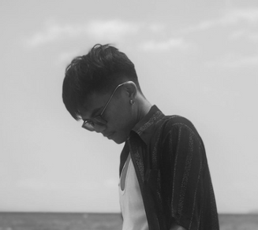
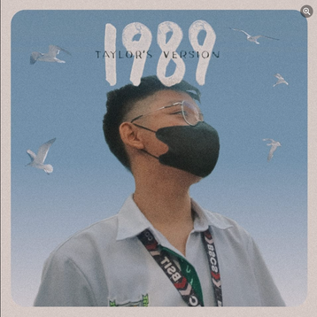
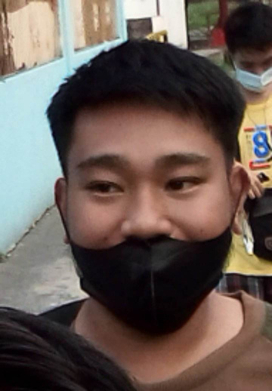
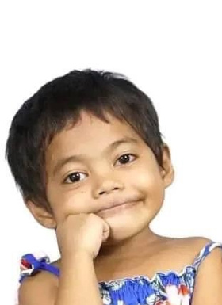


Our Team
Laira Samis
Christian Perez
Karl Miranda
Mark Acedo
Ronan Renz Valencia
JM Bernardo

Slide 3
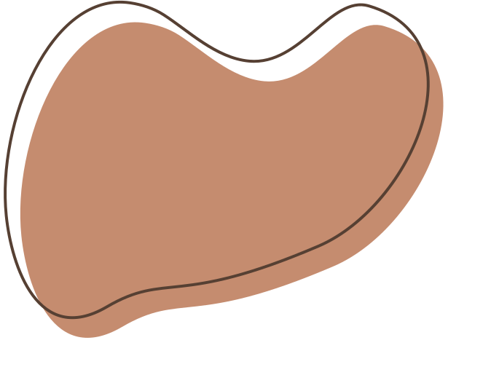


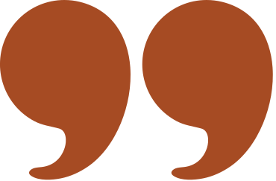




Topic
Daling Daling
Ragragsakan

Slide 4



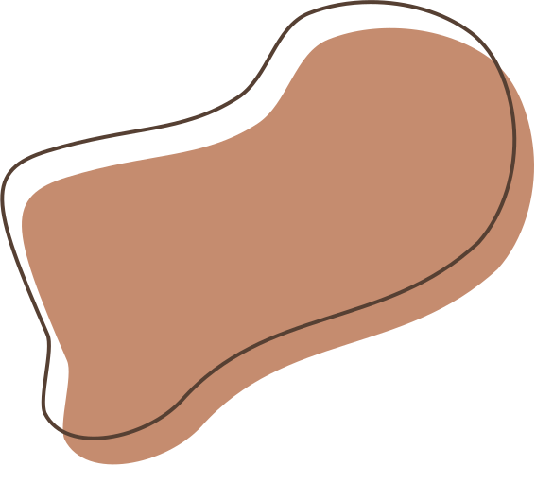


Daling-Daling

Slide 5

Cultural History
Daling-daling is a courtship dance from Jolo, Sulu. This is a popular among the young people of that locality.
The word daling means my love. The name of the dance, therefore, means "my love, my love".
The dancers sing as they perform the dance or the audience may sing while the dancers perform the dance. The song reveals how two lovers care for each other.
The boys tells the girl that there is no peace in his mind when he is away from her. The girl, on the other hand, says that even if they were in two separate islands her love for him would never change.

Slide 6



Dance Characteristics
Daling-Daling footwork uses Point-step. Point R (L) foot in front (ct. 1), step with the same foot in place with a slight bending of knees while the movement of your hands.
With an open fan held in each hand, raise arms sideward at shoulder level with elbow straight, but relaxed. Turn hands (from the wrist only) in a horizontal figure eight motion in two counts.
Accompanying the dance is a cheerful poem recited in rapid singsong which deals with life, love, and happiness.
The lyrics are sometime spontaneous and include a liberal dose of jokes and anecdotes. Accompanying music comes from a bamboo xylophone (gabbang) and a three-stringed violin (biola).

Slide 7


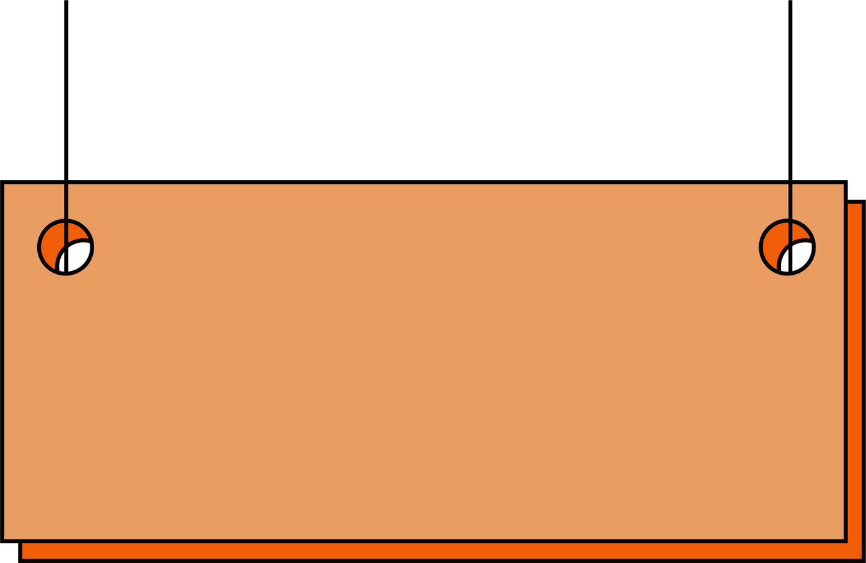
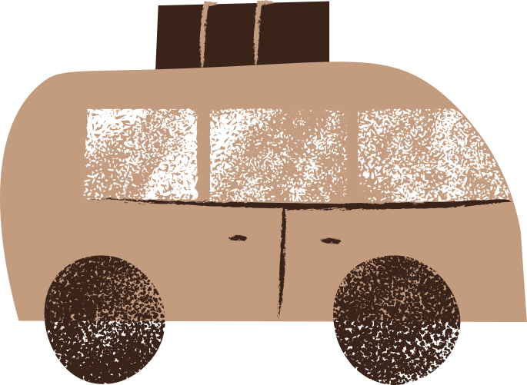

Movement Skills
Sculpture-like poses, cross-legged and kneeling stances, coupled with flowing gestures with the arms extended farthest away from the body
dancers must have dexterity and flexibility of the shoulders, elbows, and wrists – movements
The rhythmic bounces of the shoulder with simultaneous alternating waving of arms are the basic movement of this dance

Slide 8


FITNESS BENEFITS
1.
Posture Improvement
The emphasis on maintaining proper posture in Daling-Daling can lead to better alignment of the spine and improved posture even outside of the dance practice.
2.
Flexibility
The graceful and fluid movements of the dance require flexibility, helping to increase your range of motion and reduce the risk of injuries.

Slide 9
FITNESS BENEFITS
3.
Muscle Engagement
The various steps and arm movements in Daling-Daling engage different muscle groups, promoting muscle strength and endurance throughout the body.
4.
Coordination
Daling-Daling involves complex footwork and coordinated arm movements, enhancing your motor skills and overall coordination.

Slide 10

DIETARY GOAL
Overall Objective: Provide nourishment for sustained energy and well-being during slow and gentle folk dance practices and performances.
S
M
A
R
T
pecific Goal
Consume balanced meals for sustained energy.
Include a source of lean protein, whole grains, and
vegetables in each meal.
easurable
chievable
plan meals with nutrient-rich ingredients that
support overall health and energy.
elevant
Balanced meals will provide sustained energy
for gentle dance practices and performances.
Within the next month, consistently aim to include
protein, whole grains, and vegetables in each meal.
ime-bound

Slide 11

DALING DALING DANCE:

Slide 12
Ragragsakan

Slide 13
Cultural History
In Kalinga, women adopted a dance called "Ragragsakan" for a tradition where they get together to prepare for a peace pact called budong.
Derived from their neighboring municipality Ilocos, it came from an Ilocano word meaning "merriment".
Ragragsakan is also performed especially on huge occasions such as the homecoming of successful head takers and warring tribes' peace-pact culmination.

Slide 14
Dance Characteristics
In performing Ragragsakan dance, Kalinga maidens sing short Salidumay songs as they perform wave-like actions through the terrace dikes while also skipping through its breaks.
For the performance, they balance labba baskets on their heads and wave colorful tribal blankets.
From this context, the dance portrays the walk of Kalinga maidens carrying water pots while wearing the "blankets of life" around their necks as they imitate the climb up of the Banaue Rice Terraces.

Slide 15
Movement Skills
The circular movements of the dance symbolize unity and harmony among the Ibalois.
Ragragsakan dance is an adaption of a tradition in which Kalinga women gather and prepare for a budong or peace pact.
The Kalingga borrowed the beautiful word Ragragsakan from the Ilocano, which means "merriment".

Slide 16
FITNESS BENEFITS
1.
Balance and Coordination
The intricate footwork and coordinated arm movements challenge your balance and coordination, as the Ragragsakan dance involves balancing a basket on top of one's head.
2.
Posture Enhancement
The Ragragsakan dance requires main focus on keeping one's posture proper in accordance to the steps, leading to improved alignment of the spine and better posture even in everyday activities.

Slide 17
DIETARY GOAL
Overall Objective: Fuel the body for sustained energy and coordination during folk dance routines that involve balancing objects on top of the head while moving.
S
M
A
R
T
pecific Goal
Include pre-dance snacks for sustained energy and focus.
easurable
Consume a balanced snack containing carbohydrates and a touch of protein before dance practice.
Prepare snacks like whole grain crackers with cheese or a banana with almond butter.
chievable
elevant
Pre-dance snacks provide energy and mental focus during balance-focused routines.
Starting next week, Consistently have a balanced snack before dance practice for the next four months.
ime-bound

Slide 18
RAGRAGSAKAN DANCE:

Slide 19


